Slide 1
Designing a Safekeeping System with Human Touch Detection Module
Bryan Leow | R@YDSP

Slide 2
Overview
Background Info
Methodology
Results & Discussion
R@YDSP Info
Q&A

Slide 3
Overview
Background Info
Methodology
Results & Discussion
R@YDSP Info
Q&A

Slide 4
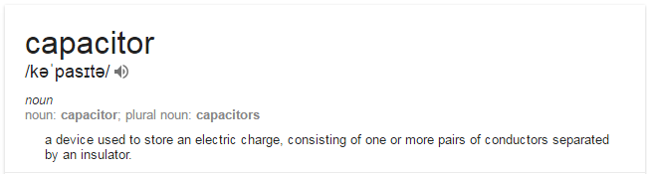
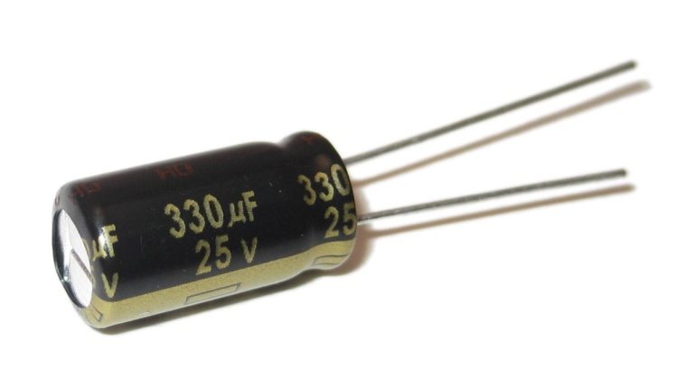
So what does “human touch detection module” mean?
It refers to any sensor that uses capacitive sensing of the human body to trigger an alarm – that is, the property of the human body that enables it to act as a capacitor.
What is a capacitor?
a 330 x 10^-6 Farad Capacitor

Slide 5
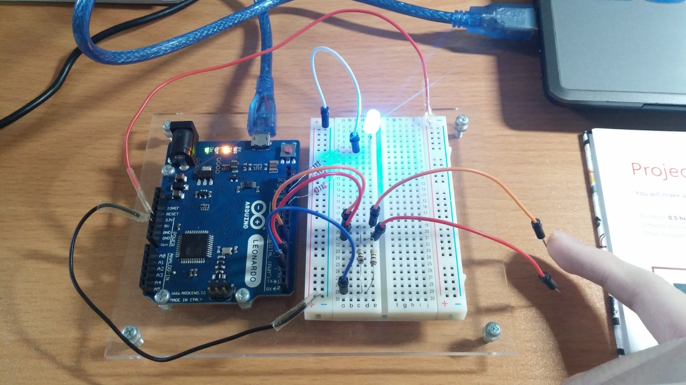
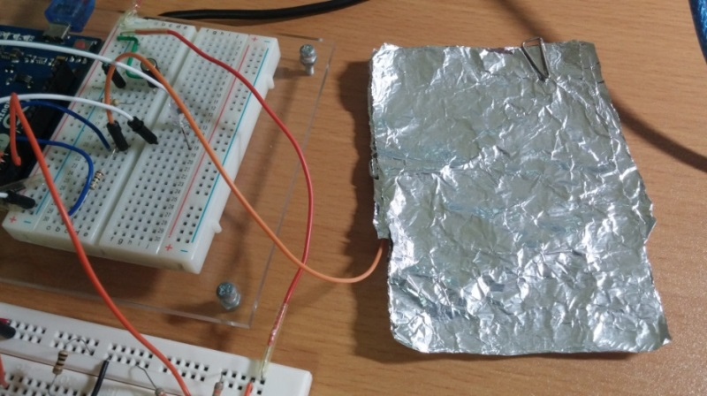
So what does “human touch detection module” mean?
An Arduino microcontroller can detect human touch using a resistor-capacitor (RC) network, formed by a single resistor and the touch electrode capacitor.
These wires are connected
This aluminium foil is the touch electrode capacitor
resistor
the Arduino microcontroller

Slide 6
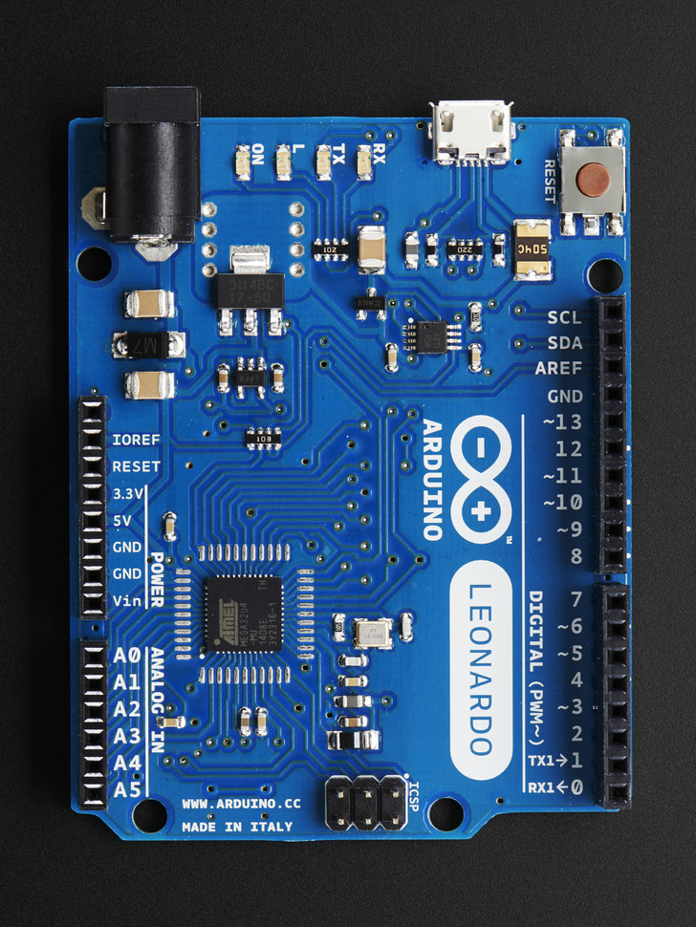
Shiny red self-destruct button
Receive pin (connected to foil)
Send pin

Slide 7
Steps involved in capacitive sensing
The send pin is toggled to a new state, and waits for the receive pin to change to this same state.
The delay between these two processes is determined by an “RC time constant” (recap: RC = resistor-capacitor), which can be represented by the following equation:
time = R x (C_{pin} + C_{touch})

Slide 8
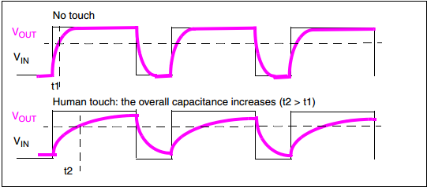
So what does “human touch detection module” mean?
Once the RC time constant is met and both pins are at the same state, the send pin will be toggled again and the cycle repeats.
This causes the receive pin to be periodically charged and discharged through the fixed resistor, the frequency of which is dependent on the time constant.
Receive pin charging
Receive pin discharging

Slide 9
So what does “human touch detection module” mean?
A touch from an electrical conductor (such as a metal object or a hand) increases C_{touch} .
Variation in the RC timing due to this is reported to the Arduino board, which can trigger further actions if it satisfies a condition as defined by the user.

Slide 10
Overview
Background Info
Methodology
Results & Discussion
R@YDSP Info
Q&A

Slide 11
The Experiments
Experiment #1: should the alarm be triggered when the RC time constant….
exceeds a pre-defined threshold value OR increases by more than a certain value within a period of time
Experiment #2: find the best value to use in our sensor

Slide 12
The Experiments
Experiment #1: Separate programmes were written for both possible designs
elapsedMillis timerMUSIC; #define intervalMUSIC1 250
void loop() {
if ( ((millis()) >= 5100) && ((newValue - oldValue) >= 10) && (tiltsensorBUFFER > 5000) ){
timerMUSIC = 0;
// When object touched | Music
switch(note)
{
case 0: //for first note
tone (SpeakerPin,262,250);
break;
case 1: //for second note
tone (SpeakerPin,310,250);
break;
}
if (timerMUSIC >= intervalMUSIC1)
{
timerMUSIC -= intervalMUSIC1;
note = !note; }
}

Slide 13
How to decide what is “better”/”best”?
Need for a framework to rate the effectiveness of the sensor.
A “SCAR” criteria was developed – Sensitivity, Consistency, Adaptability and Reliability.

Slide 14
SCAR Criteria
Sensitivity:
What is it: Receptiveness of the sensor to an approaching hand.
How to measure: Furthest distance one can keep his/her hand from the sensor and still trigger the alarm.
Consistency:
What is it: the variation in readings gathered from the Sensitivity test.
How to measure: Highest reading minus lowest reading for the five times we repeat the experiment.

Slide 15
SCAR Criteria
Reliability:
What is it: occurrences of false alarms – alarms that are triggered when they are not intended or supposed to.
How to measure: Leave the sensor running for 2 minutes without interfering
Adaptability:
What is it: how adept a sensor is to changing environments and situations.
How to measure: Perform the SCR tests in different environments and situations.

Slide 16
Overview
Background Info
Methodology
Results & Discussion
R@YDSP Info
Q&A

Slide 17
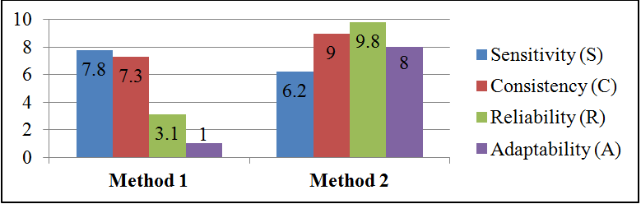
Experiment #1 | Results:
Method 1: alarm triggered when RC time constant exceeds the threshold of 100.
Method 2: alarm triggered when the increase in the RC time constant is >15 within 5 seconds.

Slide 18
Experiment #1 | Discussion:
Method 2 > Method 1.
Better in Sensitivity, Adaptability & Reliability than Method 1, which is highly unreliable with a 27% false alarm rate – more than 1 in 4 alarms could not be trusted.
Hence, we will be measuring relative difference in RC time constant to trigger the alarm.

Slide 19
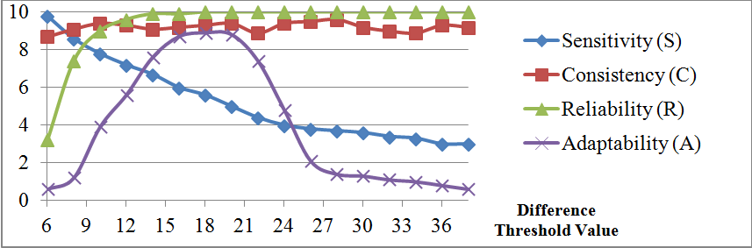
Experiment #2 | Results:
Sensitivity decreases with DTV
Consistency/Reliability: very good
Adaptability peaked at 18 DTV. At 26 DTV, the graph approached a plateau.

Slide 20
Conclusion
Concept of capacitive sensing
Steps involved in capacitive sensing
Basic preview of the programmes written
The SCAR framework to determine alarm effectiveness
Measuring relative difference is more reliable and adaptable.
DTV of 18 is the most adaptable

Slide 21
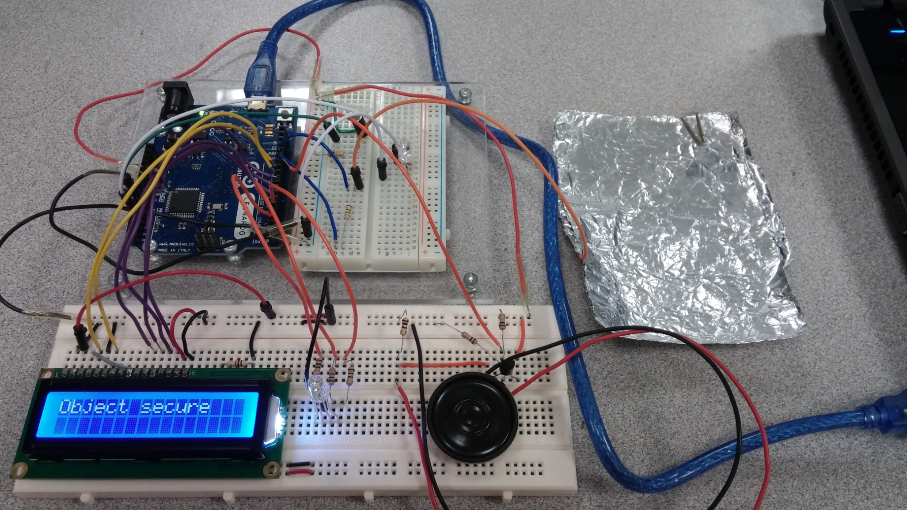
Photos

Slide 22
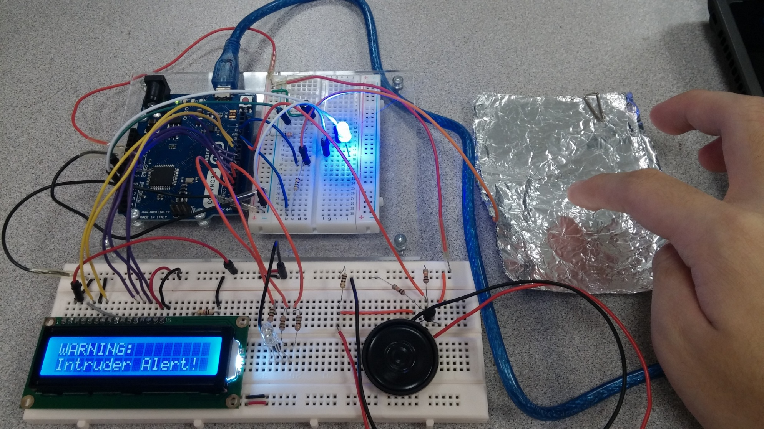
Photos

Slide 23
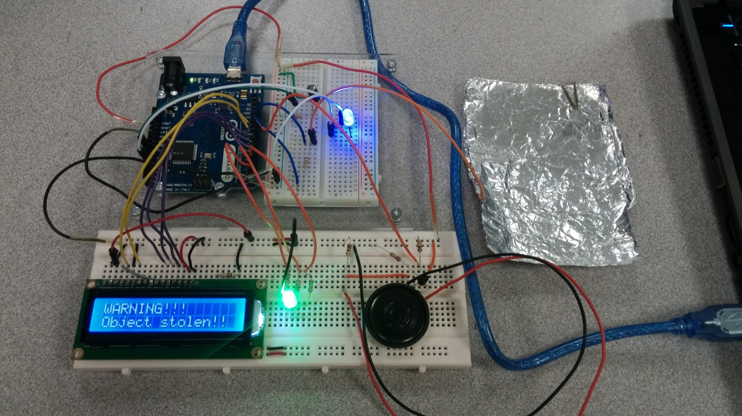
Photos

Slide 24
Overview
Background Info
Methodology
Results & Discussion
R@YDSP Info
Q&A

Slide 25

R@YDSP | Mentorship
Faculty of Engineering, National University of Singapore (NUS)
Attached to Associate Professor Arun Shankar Narayanan

Slide 26
R@YDSP | Attachment
Supposed attachment period:
1st October 2015 – 31st December 2015, daily
Actual attachment
21st October 2015 – 31st December 2015
Once a week to check progress
Worked the rest from home

Slide 27
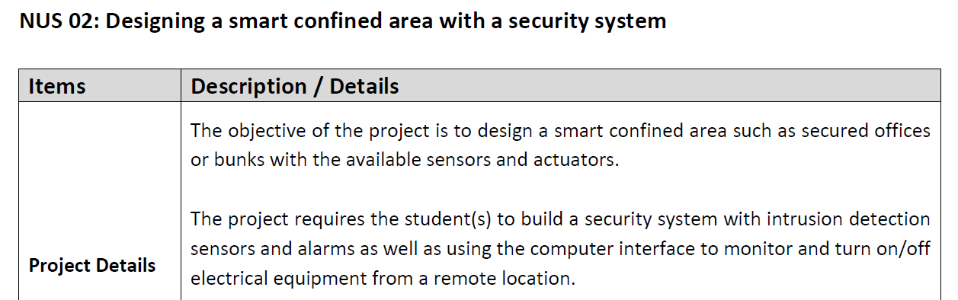
R@YDSP | Project
Supposed project:
.

Slide 28

R@YDSP | Project
Actual project:
.

Slide 29
R@YDSP
Point is, R@YDSP is flexible
Not necessarily daily attachment
Can explore other areas of your project
Join if you’re interested in picking up some skills in science and technology (engineering, computing, nanotechnology)

Slide 30
R@YDSP
T H A N K
Y O U
:>

